Slide 1
Multiple features
Linear Regression with multiple variables

Slide 2
Different names
Number of dependent & independent variables
Regression and nature of dependent variable
Nature of the model assuming y=f(x₁, x₂, ..., x_{n})
House Price Prediction Example (Next Slide)

Slide 3


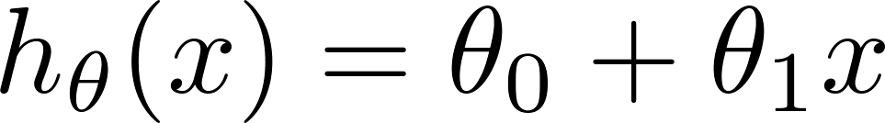
Multiple features (variables).
Size (feet²) | Price ($1000)
2104 | 460
1416 | 232
1534 | 315
852 | 178
… | …

Slide 4
Multiple features (variables).
Size (feet²) | Number of bedrooms | Number of floors | Age of home (years) | Price ($1000)
2104 | 5 | 1 | 45 | 460
1416 | 3 | 2 | 40 | 232
1534 | 3 | 2 | 30 | 315
852 | 2 | 1 | 36 | 178
… | … | … | … | …

Slide 5



Multiple features (variables).
Size (feet²) | Number of bedrooms | Number of floors | Age of home (years) | Price ($1000)
2104 | 5 | 1 | 45 | 460
1416 | 3 | 2 | 40 | 232
1534 | 3 | 2 | 30 | 315
852 | 2 | 1 | 36 | 178
… | … | … | … | …
Notation:
= number of features
= input (features) of training example.
= value of feature in training example.
Notes:
Pop-up Quiz

Slide 6
Hypothesis:
Previously:

Slide 7
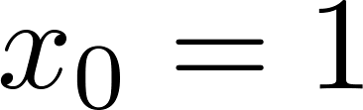
For convenience of notation, define .
Multivariate linear regression.

Slide 9
Gradient descent for multiple variables
Linear Regression with multiple variables

Slide 10
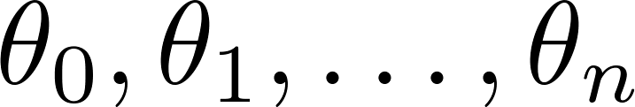
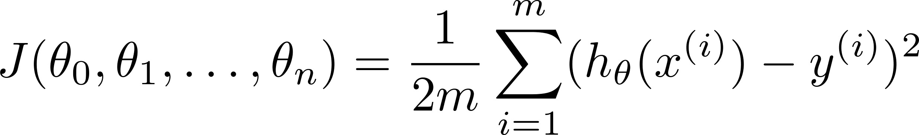

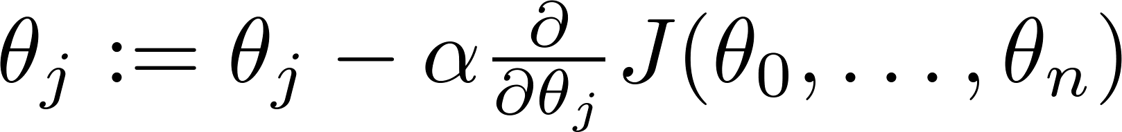

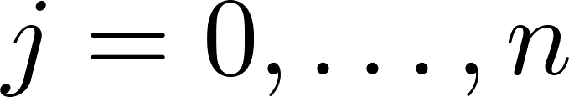
Hypothesis:
Parameters:
Cost function:
Gradient descent:
Repeat
(simultaneously update for every )

Slide 11
Hypothesis:
Parameters:
Cost function:
Gradient descent:
Repeat
(simultaneously update for every )

Slide 12

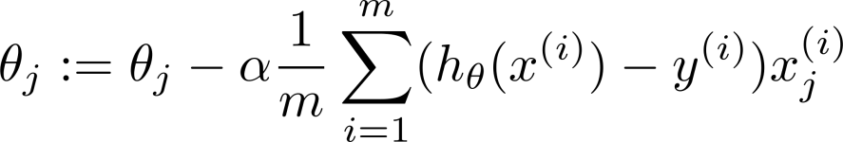
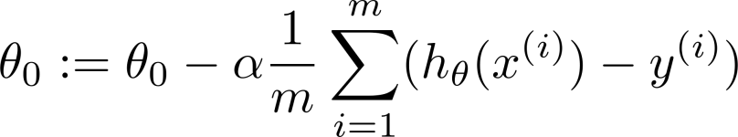



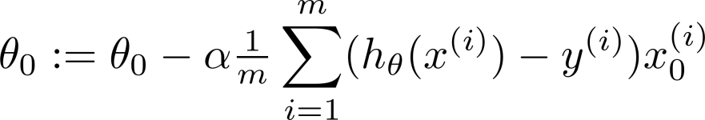
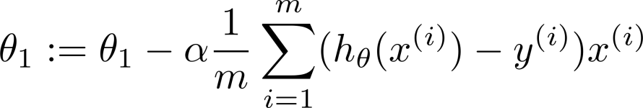
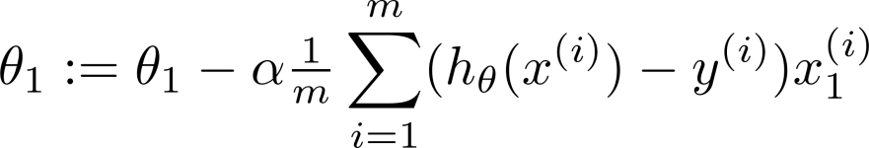

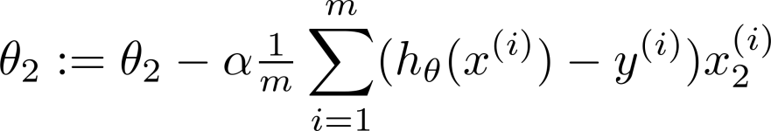
New algorithm :
Gradient Descent
Repeat
Previously (n=1):
Repeat
(simultaneously update for
)
(simultaneously update )

Slide 13
Gradient descent in practice I: Feature Scaling
Linear Regression with multiple variables

Slide 14
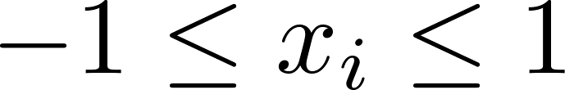
Feature Scaling
Get every feature into approximately a range.

Slide 17

Gradient descent in practice II: Learning rate
Linear Regression with multiple variables
Machine Learning

Slide 18
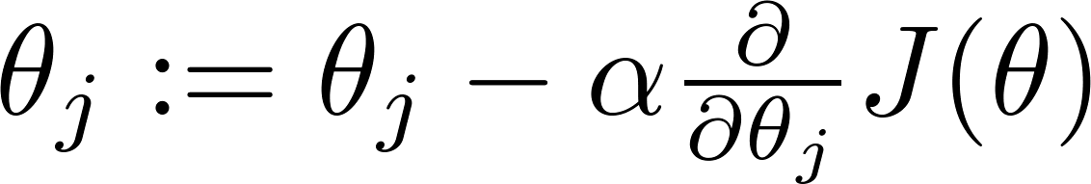

Gradient descent
“Debugging”: How to make sure gradient descent is working correctly.
How to choose learning rate .

Slide 19
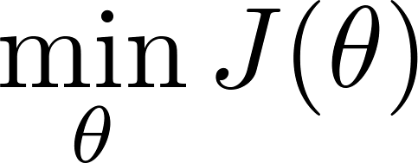
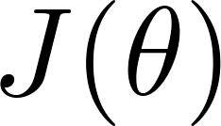
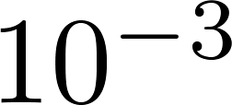
Making sure gradient descent is working correctly.
Example automatic convergence test:
Declare convergence if decreases by less than in one iteration.
No. of iterations

Slide 20

Making sure gradient descent is working correctly.
Gradient descent not working.
Use smaller .
No. of iterations
No. of iterations
No. of iterations
For sufficiently small , should decrease on every iteration.
But if is too small, gradient descent can be slow to converge.

Slide 21
Summary:
If is too small: slow convergence.
If is too large: may not decrease on every iteration; may not converge.
To choose , try

Slide 23
Features and polynomial regression
Linear Regression with multiple variables
Machine Learning

Slide 24
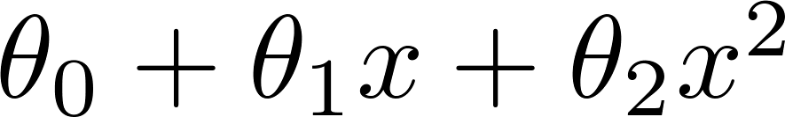
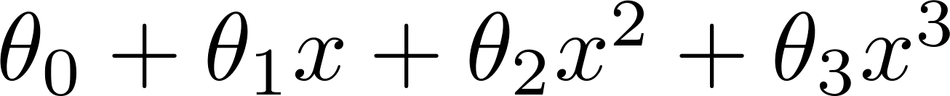
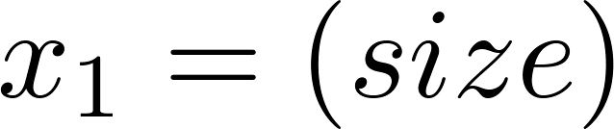
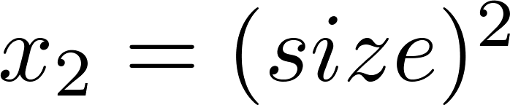
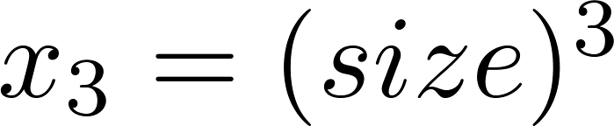
Polynomial regression
Price
(y)
Size (x)

Slide 25
Choice of features
Price
(y)
Size (x)

Slide 27
Normal equation
Linear Regression with multiple variables
Machine Learning

Slide 28

Gradient Descent
Normal equation: Method to solve for
analytically.

Slide 29
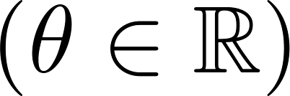
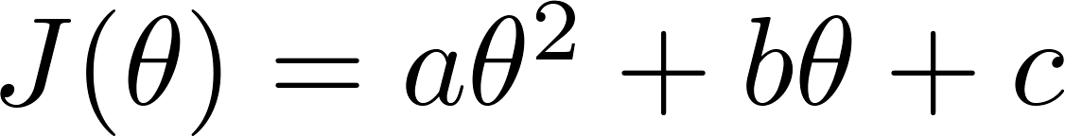

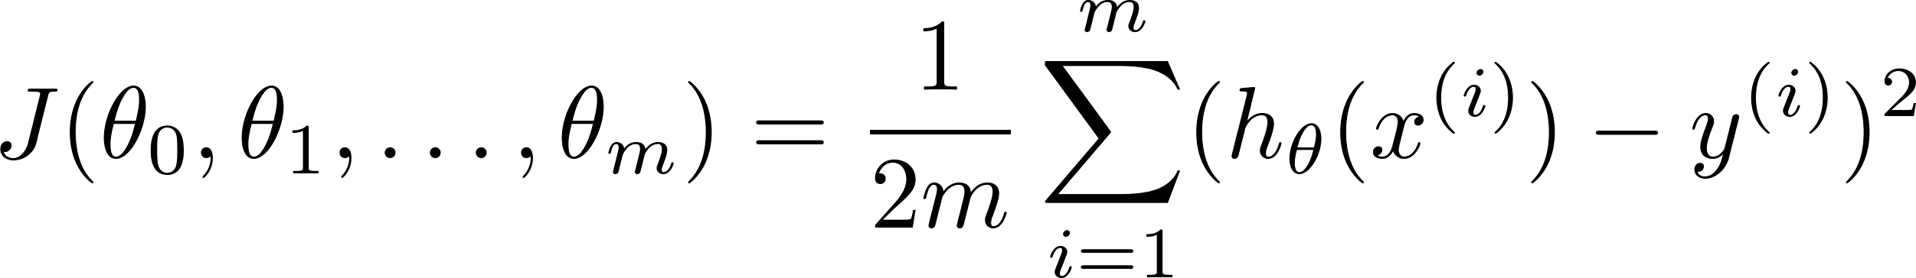
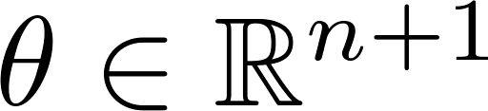
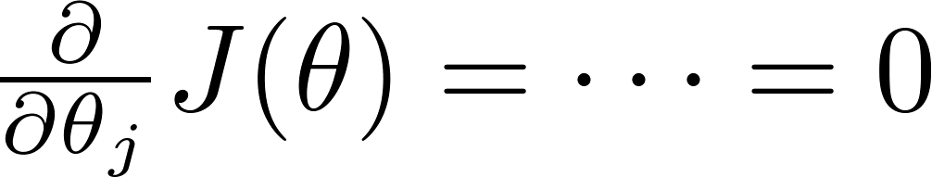

Intuition: If 1D
(for every )
Solve for

Slide 30






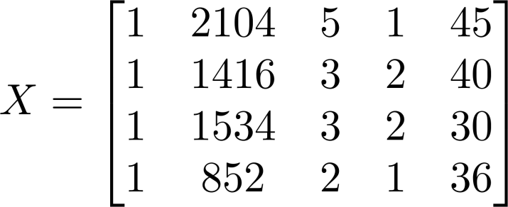
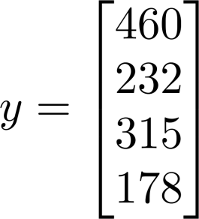
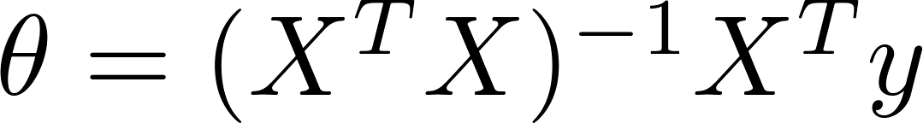
Examples:
 | Size (feet²) | Number of bedrooms | Number of floors | Age of home (years) | Price ($1000)
1 | 2104 | 5 | 1 | 45 | 460
1 | 1416 | 3 | 2 | 40 | 232
1 | 1534 | 3 | 2 | 30 | 315
1 | 852 | 2 | 1 | 36 | 178
Size (feet²) | Number of bedrooms | Number of floors | Age of home (years) | Price ($1000)
2104 | 5 | 1 | 45 | 460
1416 | 3 | 2 | 40 | 232
1534 | 3 | 2 | 30 | 315
852 | 2 | 1 | 36 | 178
Notes:
Pop-up Quiz

Slide 31
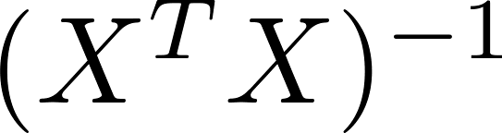
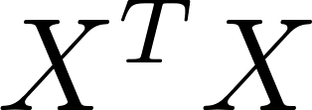
Show the derivation for this equation on Board.
is inverse of matrix .
Octave:
pinv(X’*X)*X’*y

Slide 32


training examples, features.
Gradient Descent
Normal Equation
Need to choose .
Needs many iterations.
No need to choose .
Don’t need to iterate.
Works well even when is large.
Need to compute
Slow if is very large.

Slide 33
Normal equation and non-invertibility (optional)
Linear Regression with multiple variables
Machine Learning

Slide 34
Normal equation
What if is non-invertible? (singular/ degenerate)
Octave:
pinv(X’*X)*X’*y

Slide 35


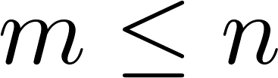
What if is non-invertible?
Redundant features (linearly dependent).
E.g. size in feet²
size in m²
Too many features (e.g. ).
Delete some features, or use regularization.

Slide 38

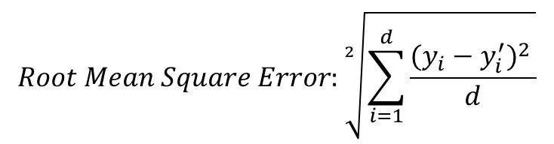
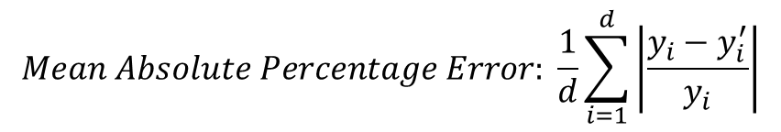
Error Measures
$$Mean Absolute Percentage Error: \frac{1}{d}\sum_{i=1}^{d}{\left|\frac{y_{i}−y_{i}^{′}}{y_{i}}\right|}$$
$$Root Mean Square Error:\sqrt[2]{\sum_{i=1}^{d}{\frac{{(y_{i}−y_{i}^{′})}^{2} }{d}}}$$
$$NRMSE= \frac{RMSE}{y_{max}−y_{min}}$$

Slide 39
Evaluating Predictor
Training + Test Set (Holdout Set)
Cross Validation
Training + Validation + Test Set
Training + Test Set and Cross Validation of Training Set for Model Selection

Slide 40
References
Andrew Ng’s slides on Multiple Linear Regression from his Machine Learning Course on Coursera.
Data Mining Book from Han and Kamber

Slide 41
Disclaimer
Content of this presentation is not original and it has been prepared from various sources for teaching purpose.

